Slide 1
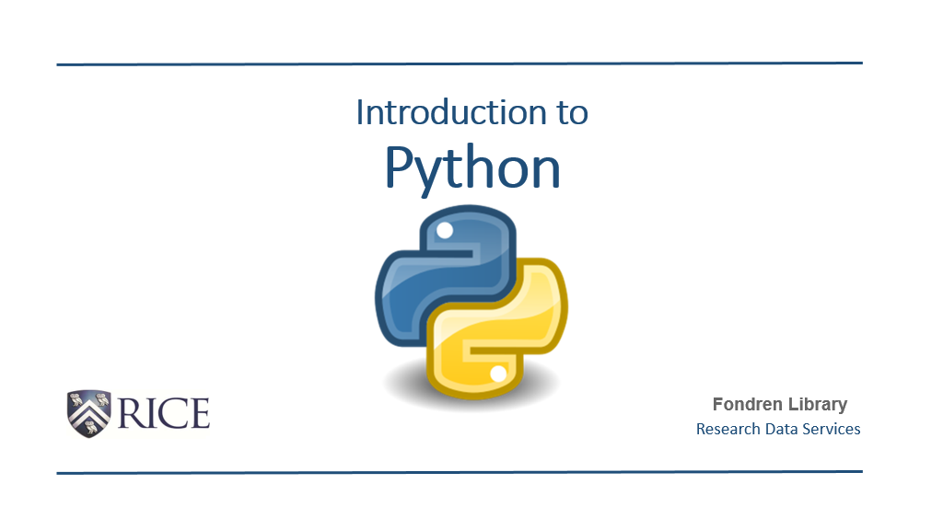


Slide 2
Introductions | Welcome to Python
Full Name
Current Career/Job
Dream Computing Project
Why Python?
Major Concerns for Learning Python

Slide 3
Programming is the process of creating a set of instructions that tell a computer how to perform a task. It involves writing code in a programming language to solve problems or automate tasks. By programming, we can develop software, apps, and websites, or analyze and visualize data. It combines logic, creativity, and technology to turn ideas into functional digital solutions.

Slide 4
Python is a versatile and widely-used programming language known for its simplicity and readability. It supports multiple programming paradigms, including procedural, object-oriented, and functional programming. Python's extensive libraries and frameworks make it an excellent choice for web development, data analysis, artificial intelligence, scientific computing, and more. Its community-driven development ensures it remains modern and accessible to beginners and experts alike.

Slide 5
Example 1: Basic Arithmetic Calculator
#This program adds two numbers provided by the user
#Get input from the user
number1 = float(input("Enter first number: "))
number2 = float(input("Enter second number: "))
#Add the two numbers
sum = number1 + number2
#Display the result
print("The sum of", number1, "and", number2, "is", sum)

Slide 6
Example 2: Email Address Validator
import re
#Function to validate an email address using regular expressions
def validate_email(email):
pattern = r'^[a-z0-9._%+-]+@[a-z0-9.-]+\.[a-z]{2,}$'
if re.match(pattern, email):
return "Valid Email"
else:
return "Invalid Email"
#Example usage
email_input = input("Enter an email address to validate: ")
result = validate_email(email_input)
print(result)

Slide 7
#Main function to handle the workflow
def main():
sales_data = read_sales_data('sales_data.txt')
total, average = calculate_summary(sales_data)
print(f"Total Sales: ${total:.2f}")
print(f"Average Sale: ${average:.2f}")
#This line will run the main function when the script is executed
if __name__ == "__main__":
main()
Example 3: Sales Report Summary
#This program reads sales data from a text file, calculates total and average sales, and prints a summary
def read_sales_data(filename):
sales = []
with open(filename, 'r') as file:
for line in file:
#Convert each line to a float and add to the list
sales.append(float(line.strip()))
return sales
def calculate_summary(sales):
total_sales = sum(sales)
average_sales = total_sales / len(sales)
return total_sales, average_sales

Slide 8
Welcome to Python | Class Set-Up
10 Weekly Mini-Projects (25%)
10 Weekly Quizzes (25%)
5 Pre-Project Quizzes (10%)
1 Final Capstone Project (40%)
Module 1 Assignment and Quiz drops Wednesday at 9AM EST. It will be due Sunday at 11:59PM EST.

Slide 9
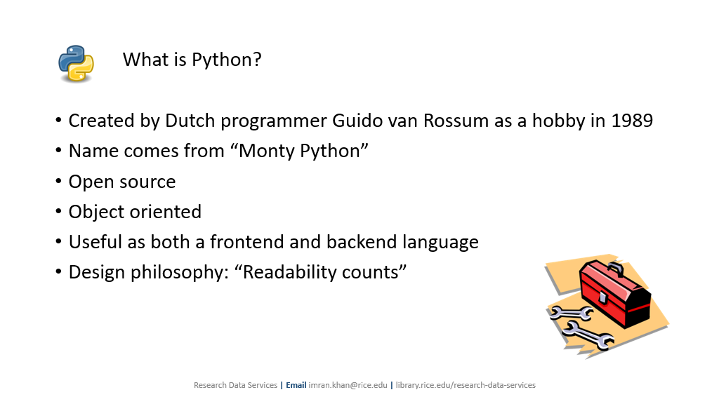

Slide 10
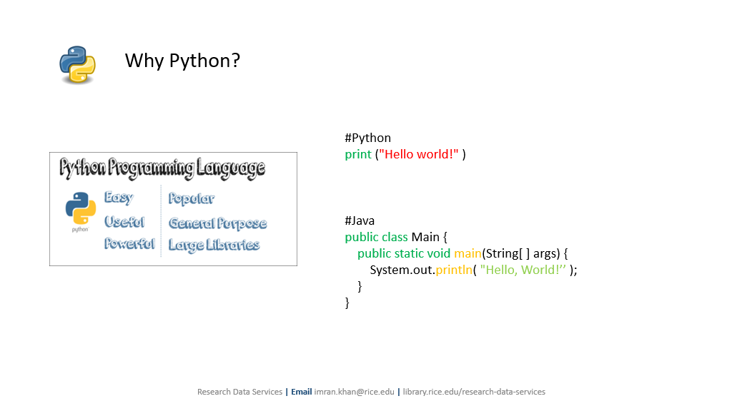

Slide 11
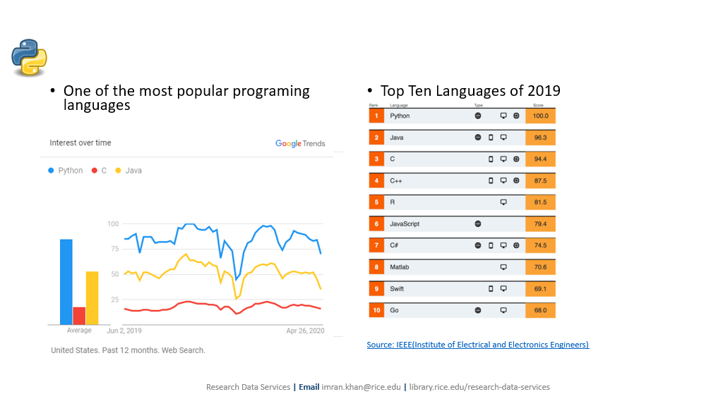

Slide 12
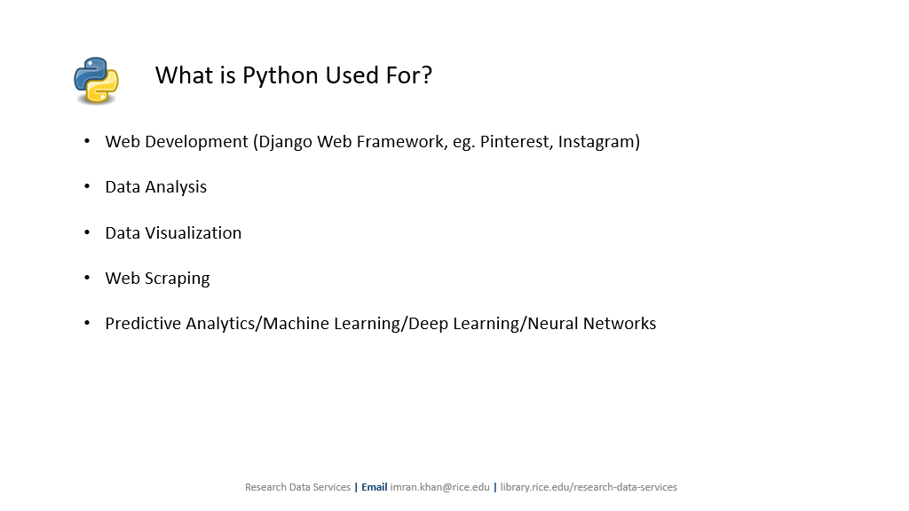

Slide 13
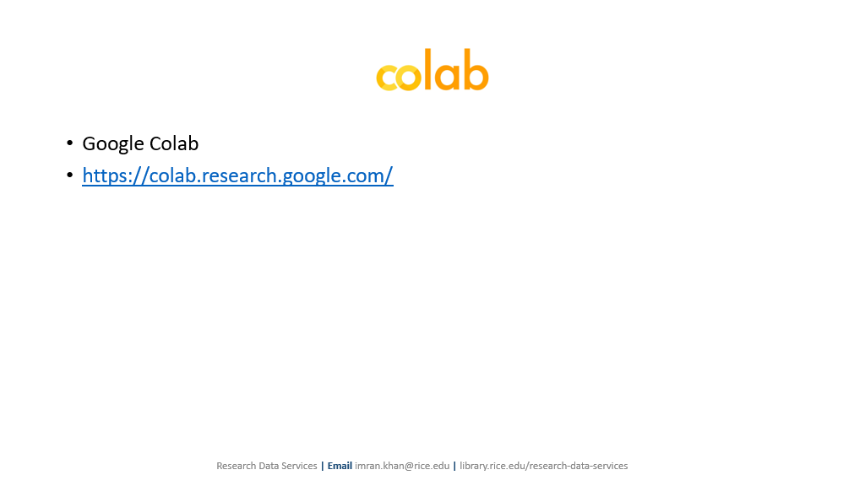
Also:
Google Colab https://colab.research.google.com/
Jupyter Notebooks https://jupyter.org/try
Visual Studio Code (My Favorite!) https://code.visualstudio.com/
Terminal (Search for Terminal)
Replit https://replit.com/~

Slide 14
Office Hours - 8PM to 9PM

